Slide 1

THE LAYERED TETRAD
CHAPTER 03

Slide 2
Topics
The Layered Tetrad
The Inscribed Layer
The Dynamic Layer
The Cultural Layer
The Responsibility of the Designer

Slide 3
The Layered Tetrad
The last chapter presented several frameworks
This Layered Tetrad is the framework of this class
  Expands upon those that came before it
  Considers the cultural significance and impact of games
Does not define what a game is
  Instead helps you understand and analyze
    The elements that are needed to make a game
    The dynamic behavior of those elements during play
    Both the impact of the game on culture and the affect of culture on the game
We use the term game, but this is applicable to any form of interactive media or experience

Slide 4
The Layered Tetrad
Presented in a tetrad (based on Schell's)
  Mechanics: The systems that define how the game will react to play. The elements that separate games from other media
  Aesthetics: The looks, sounds, smells, tastes, and tactile sensations of the game. Game art, sound, and more.
  Technology: The underlying tech that makes the game work.
  Narrative: The story, premise, characters, etc. of the game. Renamed from Schell's to show its breadth.
Presented in three layers
  Inscribed: The game as created and encoded by the developers
  Dynamic: The game's behavior during play
  Cultural: The game's relationship to society

Slide 5
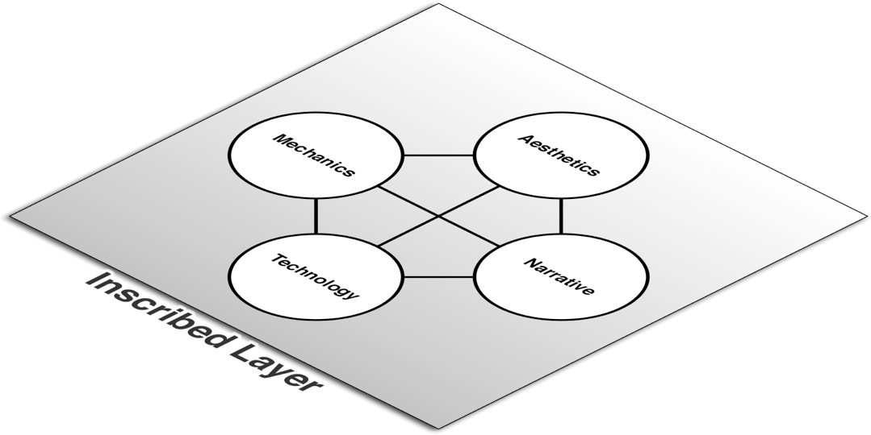
The Inscribed Layer
Game as created and encoded by developers
Similar to Schell's Elemental Tetrad
Limited to elements that exist when the game is not being played

Slide 6
The Inscribed Layer
Mechanics
  Systems that define how the player and game will interact
  Includes: Player interaction pattern, Objective, Rules, Resources, Boundaries
Aesthetics
  How the game looks, sounds, smells, tastes, and feels
Technology
  Paper and digital technology that enable gameplay
Narrative
  Authored premise, characters, and plot

Slide 7

The Dynamic Layer
The game as it is being played
Players move the game into the dynamic layer
Players

Slide 8
The Dynamic Layer
Mechanics
  Players' interactions with inscribed mechanics
  Includes: Procedures, Strategies, Emergent game behavior, Outcome
Aesthetics
  Aesthetics that are generated during play
  Play environment
Technology
  Execution of inscribed technology and code
Narrative
  Narrative created as a part or result of gameplay

Slide 9

The Cultural Layer
The game beyond play
Intersection of game community and society
Society
Communities
Players

Slide 10
The Cultural Layer
Mechanics
  Game mods created by players that alter the Inscribed Layer
  Impact of emergent play on society
Aesthetics
  Fan art, remixes, cosplay
  Does not include authorized transmedia
Technology
  Game tech used for non-game purposes
  Effect of external cheating technology on game
Narrative
  Fan-made narratives

Slide 11
The Cultural Layer
The divisions between the four elements are less crisp in the Cultural Layer
  The four elements intermingle in several of the examples from the last slide
The Cultural Layer is also the only layer of a game that non-players will ever see
  People who don't play a game experience it through the stories told by those who have
  The collision of the community of players and larger society
What messages are our games sending into society?

Slide 12
The Responsibility of the Designer
All designers understand their responsibility for the Inscribed Layer
  Most understand their responsibility for the Dynamic Layer
    Example of Team Fortress 2 hat behavior
Responsibility at the Cultural Layer?
  The common perception of games
    Puerile, Vulgar, Violent, Misogynistic
  Does it have to be this way?
  Games can be…
    Prosocial
    Educational
    Meaningful
    What else?

Slide 13
The Responsibility of the Designer
What can interactive media become?
  How can you as designers push the term game beyond what it means now?
  How can you make your families and friends proud that you're entering this industry?
  How can you respect your players and treat them well?
I believe that it is our responsibility as designers to
  Promote pro-social, thoughtful behavior through our games
  Respect our players and the time that they dedicate to experiencing what we create.

Slide 14
Chapter 3 – Summary
The three layers represent a transition of agency from the developers to the players of a game
  The Inscribed Layer is entirely controlled by developers
  The Dynamic Layer is controlled by both developers and players
  The Cultural Layer is influenced by developers but ultimately controlled by players and society at large
Next Chapter: The next three chapters will each tackle one of the three layers
  Chapter 4: The Inscribed Layer
  Chapter 5: The Dynamic Layer
  Chapter 6: The Cultural Layer

